Slide 1
SMART WATER IRRIGATION SYSTEM USING ARDUINO UNO
Prepared by:
SHAIK ZEBA BATOOL (1604-19-737-019)
MADIHA SIDDIQUE (1604-19-737-014)
NOHA ABDUL RAFE (1604-19-737-006)

Slide 2
OUTLINE
Introduction
Problem Statement
Existing System
Disadvantage of Existing System
Proposed System
Working of Proposed System
i. Architecture
ii. Module
iii. Code
iv. Output
Conclusion
Future Enhancement
Reference

Slide 3
1.INTRODUCTION
Internet of Things is a network of computing devices which can collect and exchange the data. Due to day-to-day activities human life is busy and it is hard to keep track of scheduled watering of plants.
Therefore, water controlling system implementation makes potential significance in home appliances. Arduino is an open-source electronics electronic platform based on easy-to-use and software. Arduino boards can read inputs and turn it into an output like activating a motor. Over the years Arduino has been the brain thousands of projects, from everyday objects to complex scientific instruments.
Using Arduino and Internet of Things, irrigation of home garden can be automated. The Smart Water Irrigation system uses a sensor that checks the moisture level in the soil and automatically turns the water pump on till the moisture level in the soil reaches up to a particular level.

Slide 4
2.Problem Statement
Nowadays, despite being an agricultural country, the number of people who die of hunger is still quite high. Access to food seems to be difficult, as price and quantity of food is still beyond the capability of the lower middle class and lower class.
Irrigation induced Crop failure is a major cause of crop loss every year, and in the age of water crises, this has been elevated to great levels. In order to keep up with increasing demand, farmers are required to increase crop efficiency, by rapidly advancing technologies.
In order to handle Irrigation issues, this system has been devised and implemented. Usually, farmers need large scale manpower to irrigate large lands simultaneously.
However Smart Water Irrigation System (SWIS) is an automatic system that facilitates automated irrigation of lands simultaneously, upon need. Smart irrigation system is a method that prevent of wasting water in small scale such as home garden or even in big scale like football or agriculture field.

Slide 5
3.Existing System
According to the agricultural view, the continuous extraction of water from earth is reducing the water level due to which lot of land is coming slowly in the zones of un-irrigated land. The existing system of manual irrigation is very inefficient about solving these issues.
In modern drip irrigation systems, the most significant advantage is that water is supplied near the root zone of the plants drip by drip due to which a large quantity of water is saved. At the present era, the farmers have been using irrigation techniques in India through manual control in which farmers irrigate the land at the regular intervals.

Slide 6



Slide 7
4.Disadvantages of existing method
This process sometimes consumes more water or sometimes the water reaches late due to which crops get dried. Water deficiency can be detrimental to plants before visible wilting occurs. Slowed growth rate, lighter weight fruit follows slight water deficiency. For people who are interested to have fresh fruits and vegetable right in their backyard, but don’t get enough time to water the garden may not want to purchase agricultural irrigation systems like drip irrigation as it will cost more and is not much useful for home gardens.
This problem can be perfectly rectified if we use automatic irrigation system in which the irrigation will take place only when there will be acute requirement of water. And it is affordable for automation of watering plants in home gardens.

Slide 8
5.Proposed System
All the lands to be irrigated manually are automatically irrigated by this system. When compared to the previous system where farmers need to frequently and constantly keep monitoring the field for signs of dryness, this system will reduce the time needed to be spent on monitoring the field.
It greatly diminishes the need for manpower by a great value. This system will be able to function even when the owner is unavailable for a small period, hence ensuring proper irrigation even in the absence of people. Also, water will not be wasted during traversal.

Slide 9
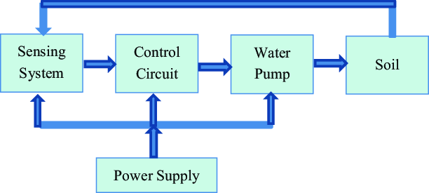
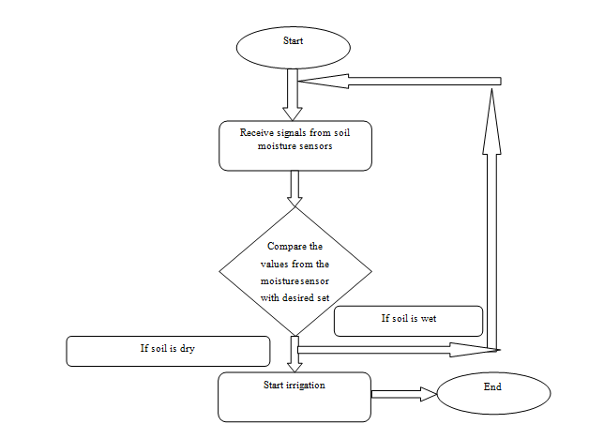
6.Working of Proposed System
i. Architecture:
Block diagram of irrigation system
Flowchart of working of smart water irrigation system

Slide 10
When the soil becomes dry, it produces large voltage drop due to high resistance, and this is sensed by the soil moisture sensor, and this resistance causes the operational amplifier to produce an output that is above the threshold value required. This causes the relay to change from normally open to closed condition – The relay becomes on. When the relay is turned on, the valve opens and water through the pipe’s rushes to the crops.
When the water content in the soil increases, the soil resistance gets decreases and the transmission of the probes gets starts to make the operational amplifier stop the triggering of the relay. Finally, the valve which is connected to the relay is stopped.
The Arduino Uno is a link between the soil moisture sensor and pumping motor. Arduino is supplied with a power of 7V to 12V. The pump motor is given a separate supply of 9V. The soil moisture sensor is used in this project because it must check soil moisture to measure the electrical conductivity of soil.
The moisture sensor provides an analogue output which can be easily interfaced with Arduino.In this project two sensors are connected to analogue pins A0 and A1 of the Arduino board. The system receives a signal from the soil moisture sensor and compares with the preset threshold value.

Slide 11
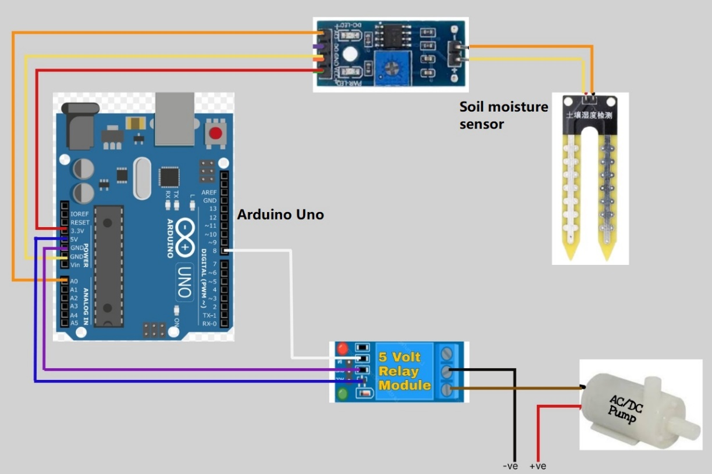
Circuit diagram of the system
ii. Module:
The operation of automated agricultural system could potentially revolutionize the irrigation process and the way it has impacted the commercial & industrial sectors. Thus, this project has been an expert or non-expert-system-based method of field monitoring for detecting dryness & treatment of the field.

Slide 12

iii. Code:
Code of Arduino program

Slide 13
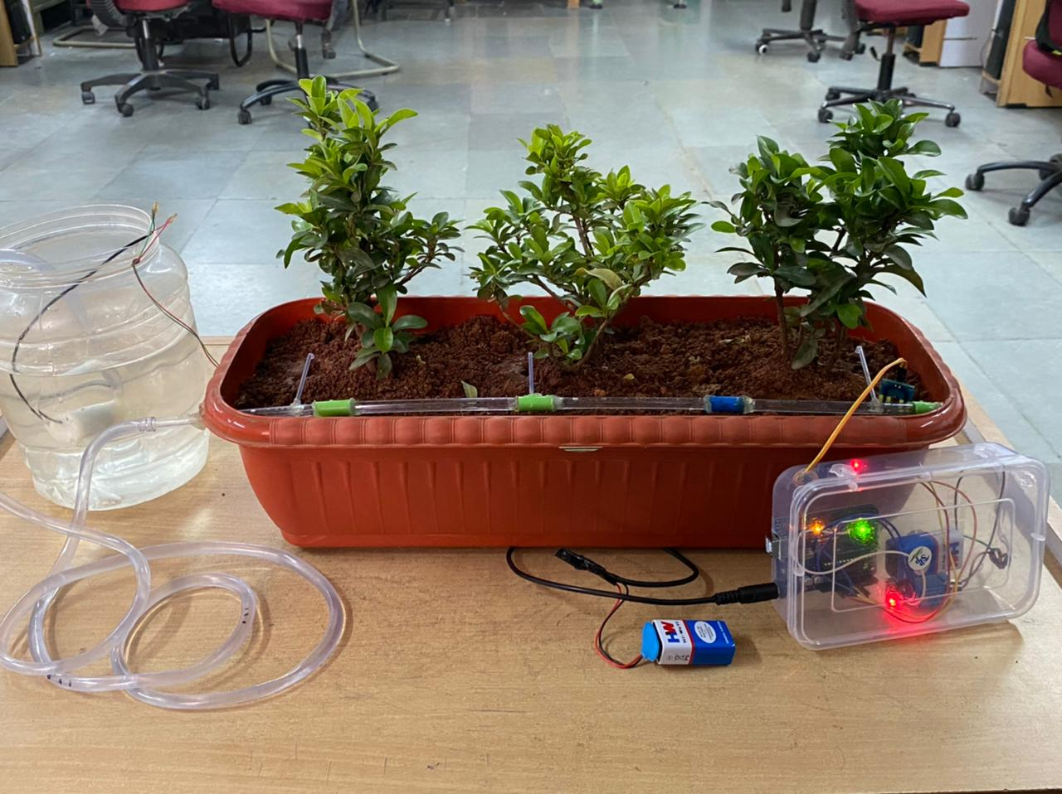
iv. Output:
Setup of Smart water irrigation system.

Slide 14
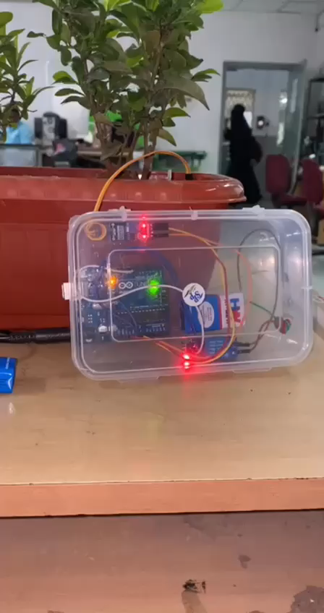
Working of the Proposed System
Demo video

Slide 15
7.Conclusion
Irrigation becomes easy, accurate and practical with the idea above shared and the output from moisture sensor and level system plays major role in producing the output. Thus the “SMART WATER IRRIGATION SYSTEM” (SWIS) has been designed and tested successfully.
When the desired moisture level is reached, the system halts on its own and the DC Motor pump is turned OFF. Thus, the functionality of the entire system has been tested thoroughly and it is said to function successfully.
The Arduino based automatic smart irrigation system is simple and precise way of irrigation. Hence, this system is very useful as it reduces manual work of the farmers and helps in the proper utilization of resources. It eliminates the manual switching mechanism used by the farmers to ON/OFF the irrigation system.

Slide 16
8.Future Enhancements
The application certainly is much more advantageous than the manual system. There will be no bias in the regions being covered and the delay is kept as minimal as it can be.
The operator does not require any previous training because of its user friendliness.
The operator is free from any technical issues.
Extremely simple design makes the circuit easy to implement and maintain.
Alterations in the system can be done easily if the process of the working changes in future.
In future according to the user’s requirement it can be updated to meet the user requirements.
Smart Wi-Fi Irrigation Controllers are next generation controllers that adjust your irrigation system automatically using real-time weather information. Moreover, you can control it from anywhere, anytime.
It can help to learn how various sensors can be deployed and utilization of their data to generate events and control irrigation systems.

Slide 17
9.References
https://www.researchgate.net/publication/359107497_SMART_IRRIGATION_SYSTEM
https://www.academia.edu/39700687/SMART_WATER_MANAGEMENT_SYSTEM
https://extension.okstate.edu/fact-sheets/smart-irrigation-technology-controllers-and-sensors.html
https://www.ncbi.nlm.nih.gov/pmc/articles/PMC7070544/
http://ageconsearch.umn.edu/bitstream/27974/1/02010009.pdf

Slide 18
THANK YOU

